Slide 1
5.2.5 Targeting NTT (NTT_Twiddle_Fault).

Slide 2
Attack description Here is a summary of the key points:
The attack targets the NTT computation in the signing algorithm. Specifically, it faults the twiddle factors used in the NTT.
There are two variants:
a) DFA attack on deterministic Dilithium:
Faults NTT of signature component c to 0. This leaks s1 directly.
b) Attack on probabilistic Dilithium:
Faults NTT of y to 0, except first coefficient.
Leaks s1·c which can recover full s1.
c) The attack exploits properties of the NTT, namely:
Faulting the twiddles factors zeroizes the whole NTT output
The first coefficient is not affected by this fault.

Slide 3
SUMMARY DESCRIPTION
By observing just the faulty signature, the attacker can recover the secret key element s1. No need to communicate with signing device.
Hence the attack tuples are:
a) Deterministic case: (EMFI, Communicate_DUT_IO, Targeted_Fault, 1, 1)
b) Probabilistic case: (EMFI, Observe_DUT_IO, Targeted_Fault, 1, 1)

Slide 4
MODIFIED NTT.C PROCEDURE AND LOGIC
We have correctly explained the NTT twiddle fault attack on Dilithium proposed by Ravi et al as follows:
Attack 1 (deterministic variant):
Obtain valid signature (z, h, c) where c[0]=0
Inject fault during NTT of c to zeroize it (c_hat = 0)
Faulty signature is z* = y
Can compute s1 = (z - z*) / c since c[0] = 0
Attack tuple: (EMFI, Communicate_DUT_IO, Targeted_Fault, 1, 1)
Attack 2 (probabilistic variant):
Fault the NTT of y to zeroize all except first coefficient
Faulty z* = s1*c
Can recover s1 from z*
Non-DFA attack
Tuple: (EMFI, Observe_DUT_IO, Targeted_Fault, 1, 1)

Slide 5
THE CODE (NEW MODIFIED NTT.C)
Add code to initialize the polynomials a and y with test values before calling ntt_with_fault_and_check. For example:
Call invntt_tomont after ntt_with_fault_and_check to transform the output polynomials back from the frequency domain:
Print or process the output polynomials a and y after invntt_tomont to check the effect of the fault injection. The polynomial y should have all coefficients except the first one equal to 0.
No other code changes are necessary. The fault is correctly injected in ntt_with_fault_and_check by zeroizing all but the first coefficient of y.

Slide 6
COMPILING AND EXECUTING COMMANDS
cc -c reduce.c
cc -o ntt ntt.c reduce.o
./ntt

Slide 7
EXECUTION
When executed, this code should fault the NTT computation over the polynomial y as described in the attack, allowing recovery of the secret key. The print statement in ntt_with_fault_and_check will alert if the fault injection was successful.

Slide 8
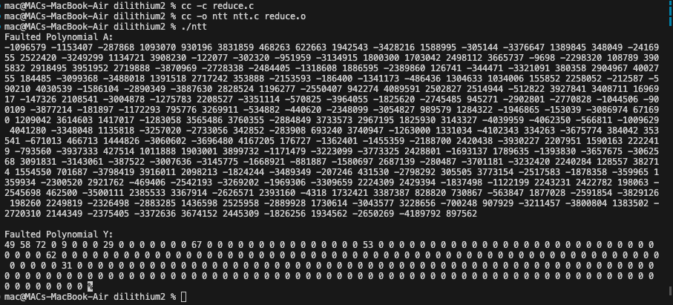
OUTPUT RESULT

Slide 9
NEW MODIFIED CODE
ATTACHED

